Slide 1

Soft Voting Classifier
Brett Tully

Slide 2

What is a Voting Classifier?
From Sklearn
Ensemble method
Classification or Regression
Uses results of multiple models to combine into one
Removes weaknesses from other models
Two types:
Soft
Hard

Slide 3
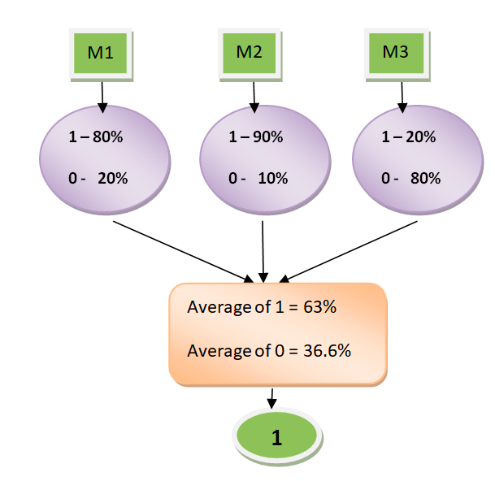
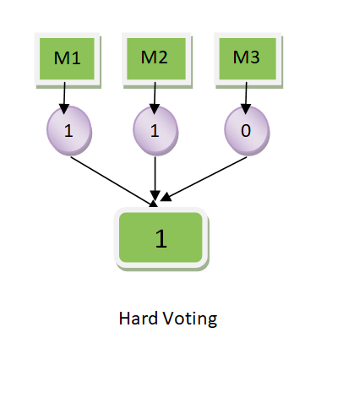
Types of Voting
Soft Voting
Hard Voting
Predicted probability vector of each model is summed and averaged.
Highest value class is chosen as the output
Classifies input data based on the mode of all the predictions made by the different classifiers

Slide 4
Star Type Classification Dataset
Kaggle.com
Independent Variables:
Temperature-Kelvin
L (Luminosity)
Radius
AM
Color
Spectral Class
Dependent Variable
Type:
Red Dwarf – 0
Brown Dwarf – 1
White Dwarf – 2
Main Sequence – 3
Super Giants – 4
Hyper Giants - 5

Slide 5
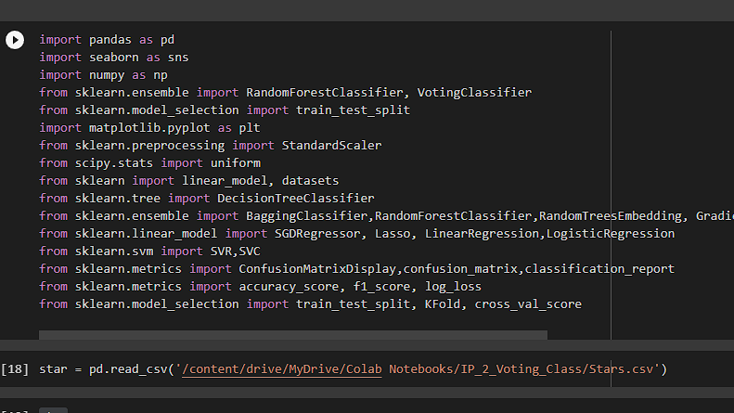

Slide 6
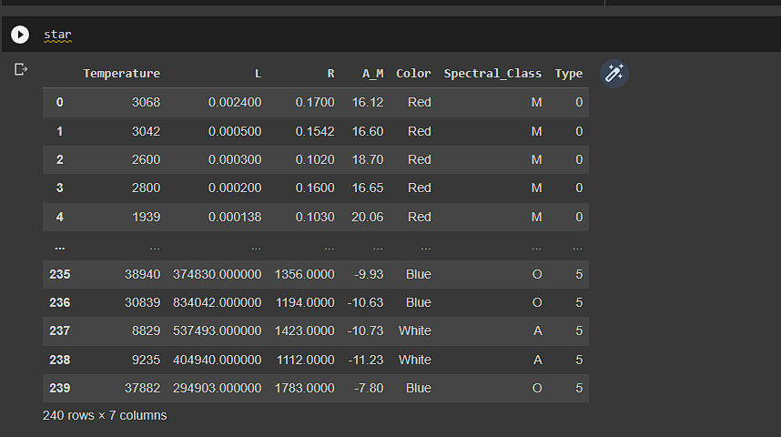

Slide 7
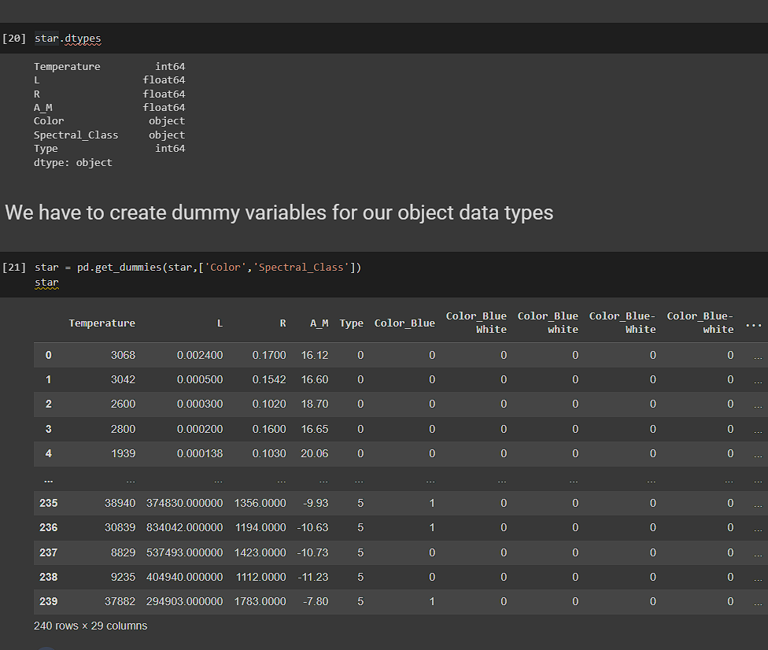

Slide 8
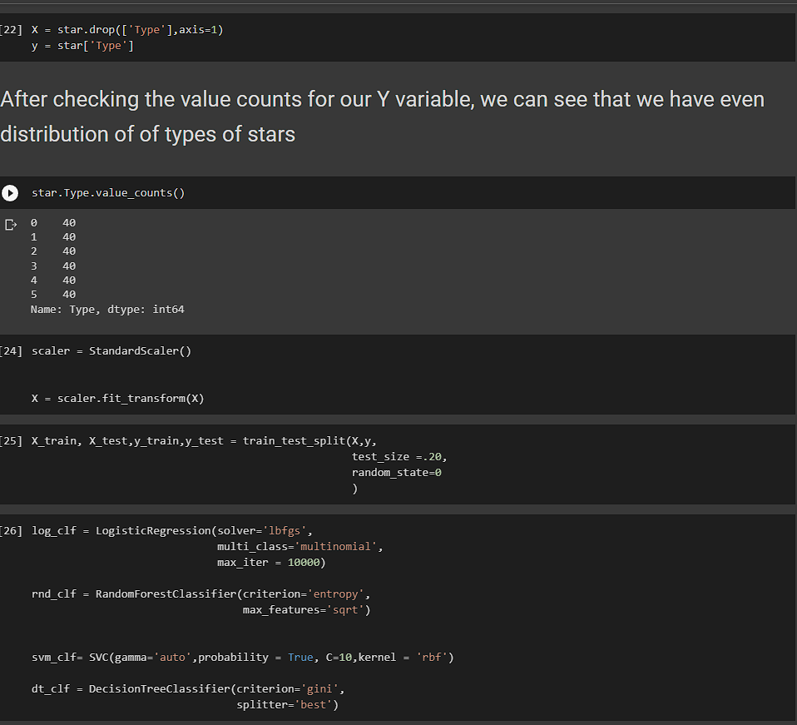

Slide 9
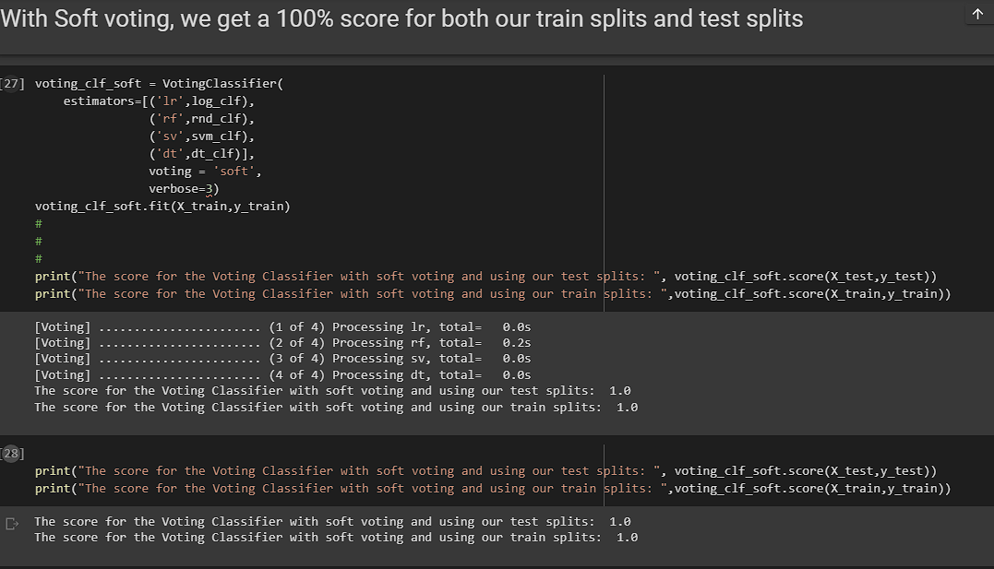

Slide 10
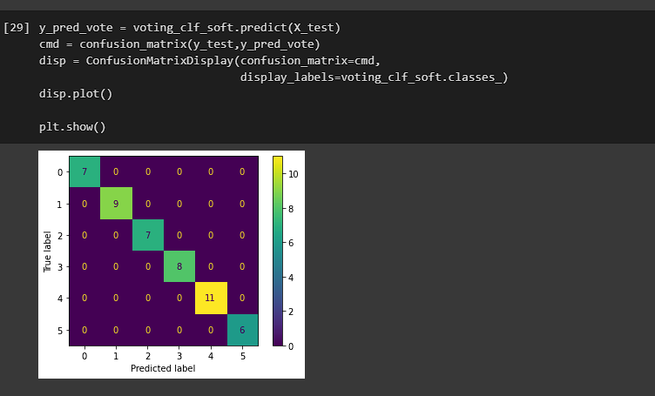

Slide 11
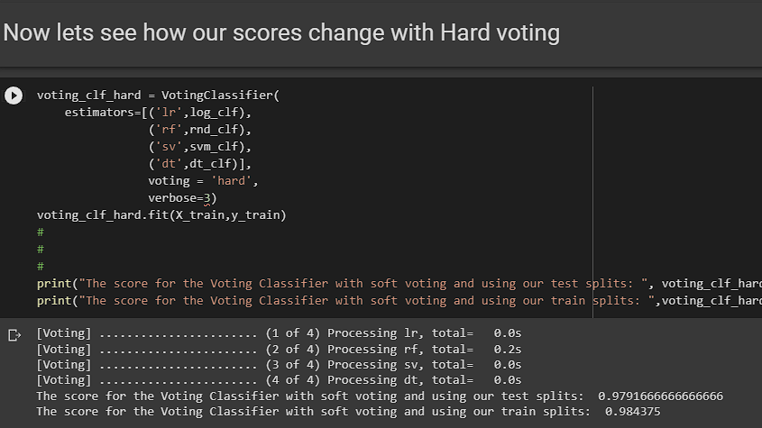

Slide 12
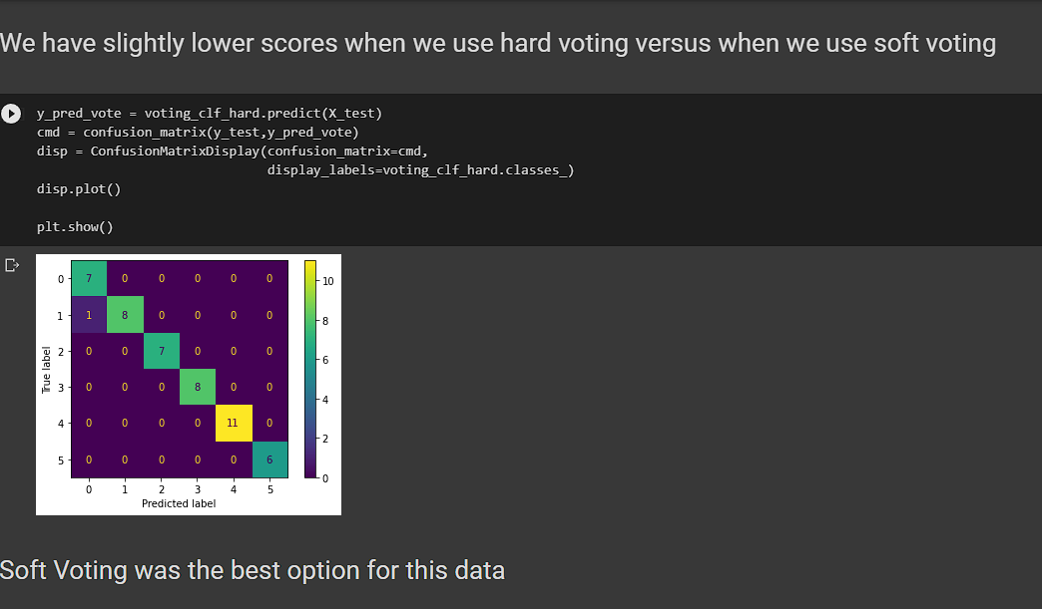

Slide 13
